Slide 1


AltarStar gameplay

Slide 2
Basic Mechanics
Player
Dash/Dodge
Press button to do a short dash to avoid enemy fire.
Grapple
Hook on to certain objects to avoid enemy fire
Weapons
Blaster – weak, fast firing weapon
Missile – strong, slow shot weapon
Lock-on Target
Puzzles
Push blocks – push blocks out of the way
Trigger – bounce object off wall to hit it into trigger location
Key Triggers – After certain requirements, trigger activates and reveals the key/opens passage.
AI/Enemies
Enemy patrol
Basic small enemy
Low health
Normal blaster
Tough enemy
Larger size
Slower speed
Medium health
Medium blaster
Mini Boss
Very large
Medium speed
High health
Strong blaster

Slide 3
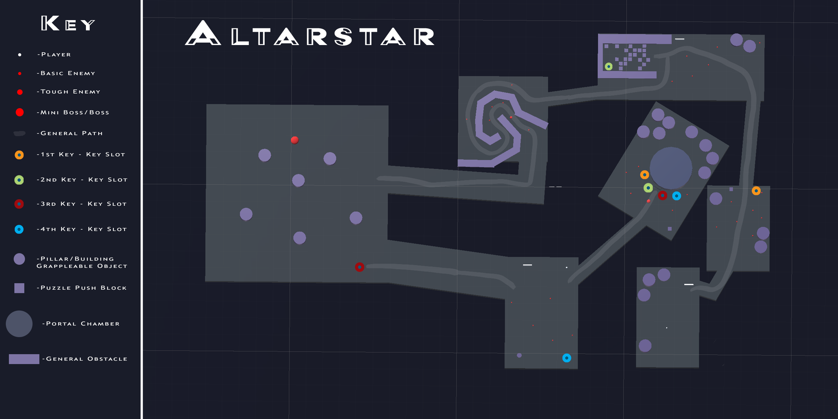

Slide 4
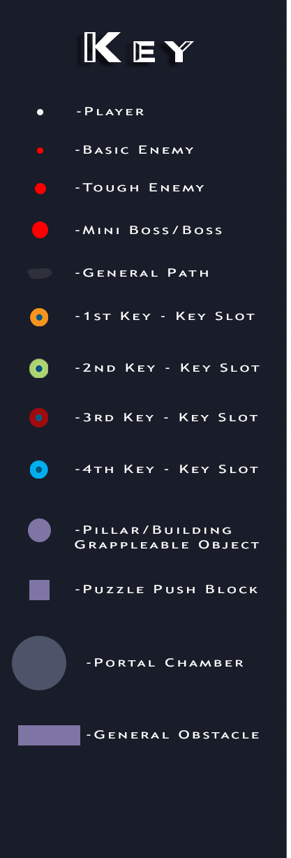
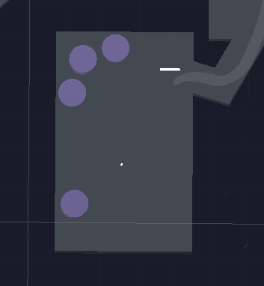
Start
Start Tutorial
Objective to collect four keys
Shooting tutorial – Shooting targets will appear. Practice shooting blaster and missiles.

Slide 5
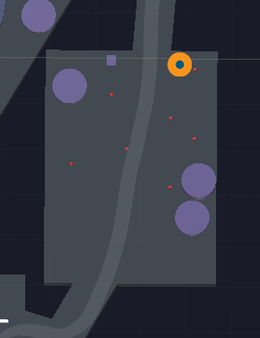
First Key
Seven enemies
Shoot them down with blaster or missiles.
After the player takes some damage, dash/dodge tutorial appears.
After enemies are defeated, step on the purple trigger and collect the first key!

Slide 7
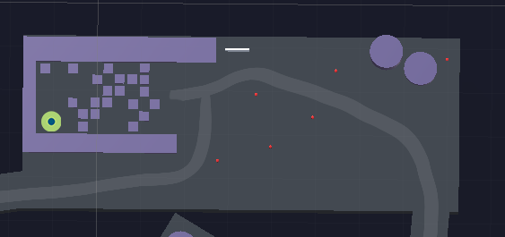
Second Key
Six enemies. Defeat them.
Make your way to the push block puzzle.
Push the blocks out of the way to make a path to the trigger and key.
Certain blocks do not move. Make sure you push the right blocks in the right direction so you don’t get stuck.

Slide 8
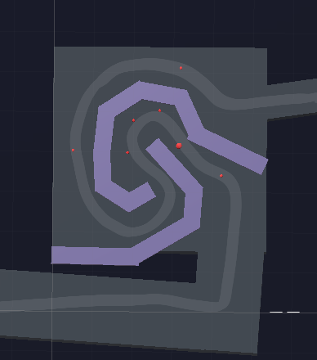
Grapple Upgrade
Seven enemies at start. More spawn. Tough enemy appears.
After you defeat the enemies, the grapple upgrade will appear.
Collect the grapple upgrade and practice by grappling to pillars along the path to the next area.

Slide 10
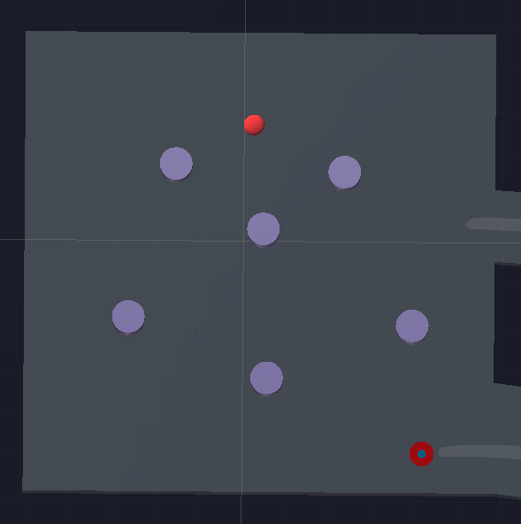
Mini Boss – Third Key
Mini Boss. Few basic enemies will spawn from corners of room.
Grapple to the pillars to make a quick escape or dodge enemy fire.
After you defeat the mini boss, the third key will appear.

Slide 12
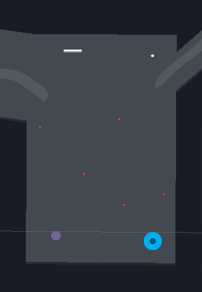
Fourth Key
Bouncing orb puzzle
Hit the orb with the player, blaster/missiles, or grapple to bounce it off the walls and into the trigger in the lower left corner.
Enemies spawn periodically.
Collect the fourth key.

Slide 14
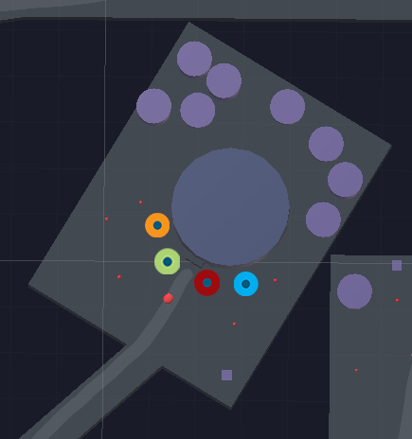
Portal Chamber Entrance
Tough enemy with basic enemies spawning.
Defeat them to activate the four key triggers.
Place the four keys collected throughout the level to gain access to the portal chamber.

Slide 15
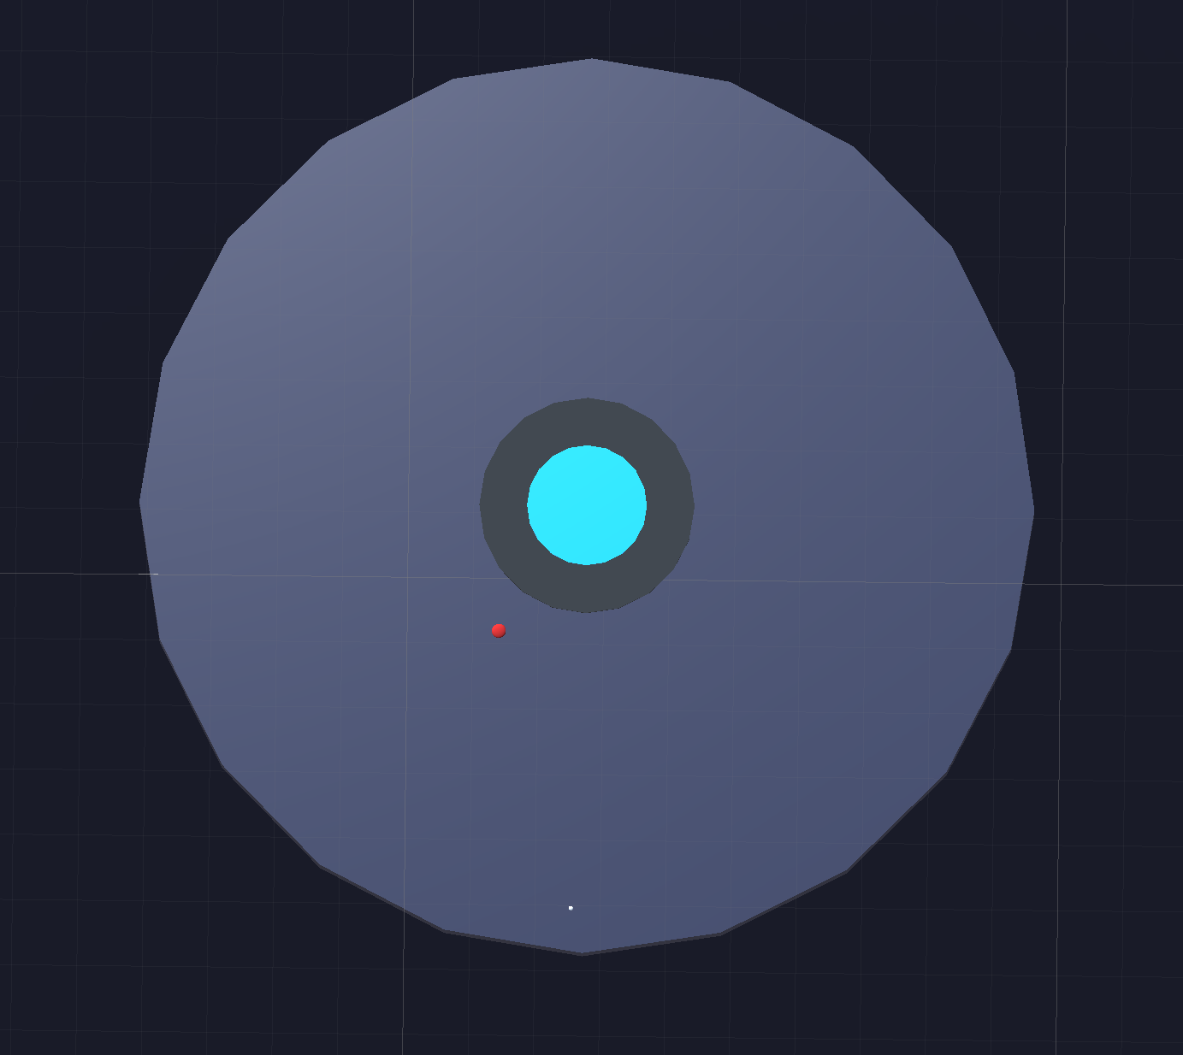
Portal Chamber
Final Boss with few basic enemies spawning.
Pillars will appear allowing use of the grapple to dodge the boss and other enemies.
Defeat the boss to access the portal and win the level!

